Slide 1

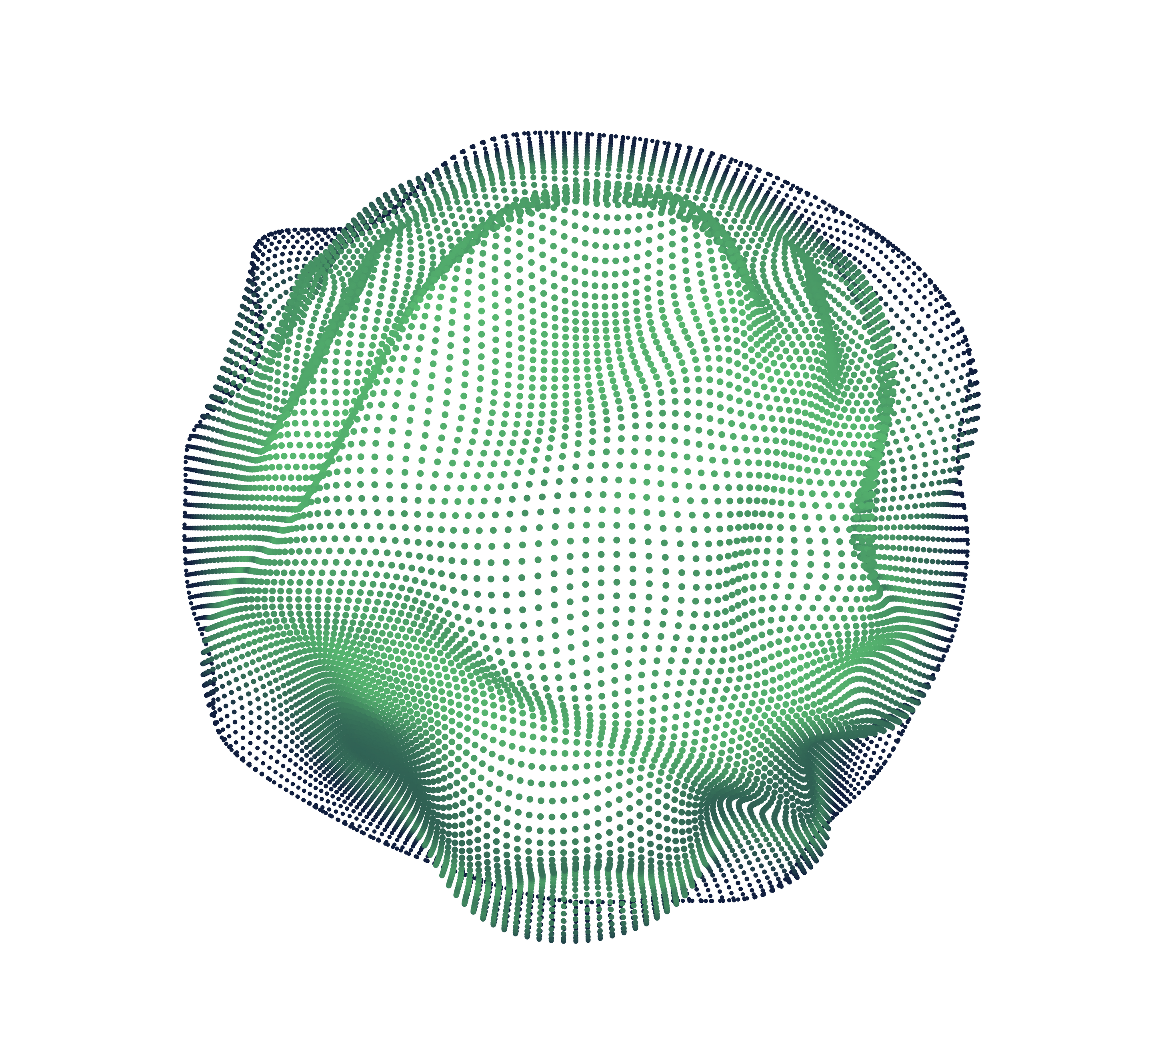
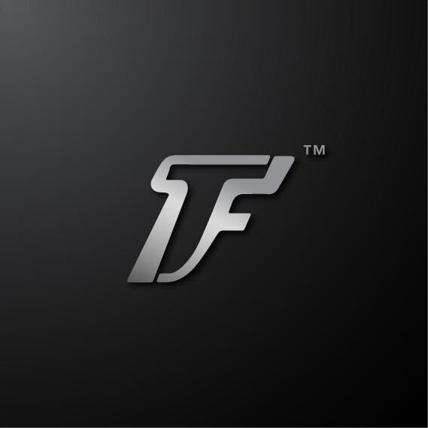

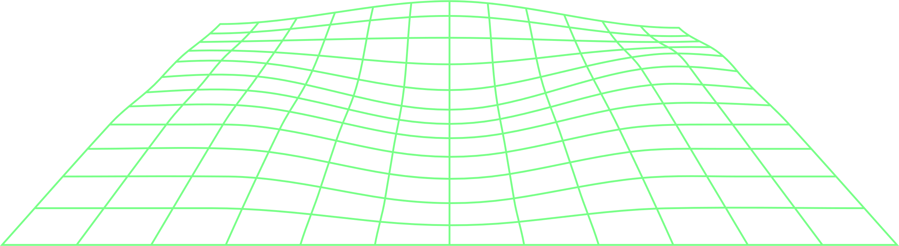
2024
VisionAI:
Advanced Object Detection
for Real-Time Applications
↙
Round-1 Final Submission
Team
"An AI-driven solution for safety, quality control, and efficiency."
PRESS HERE →

Slide 2
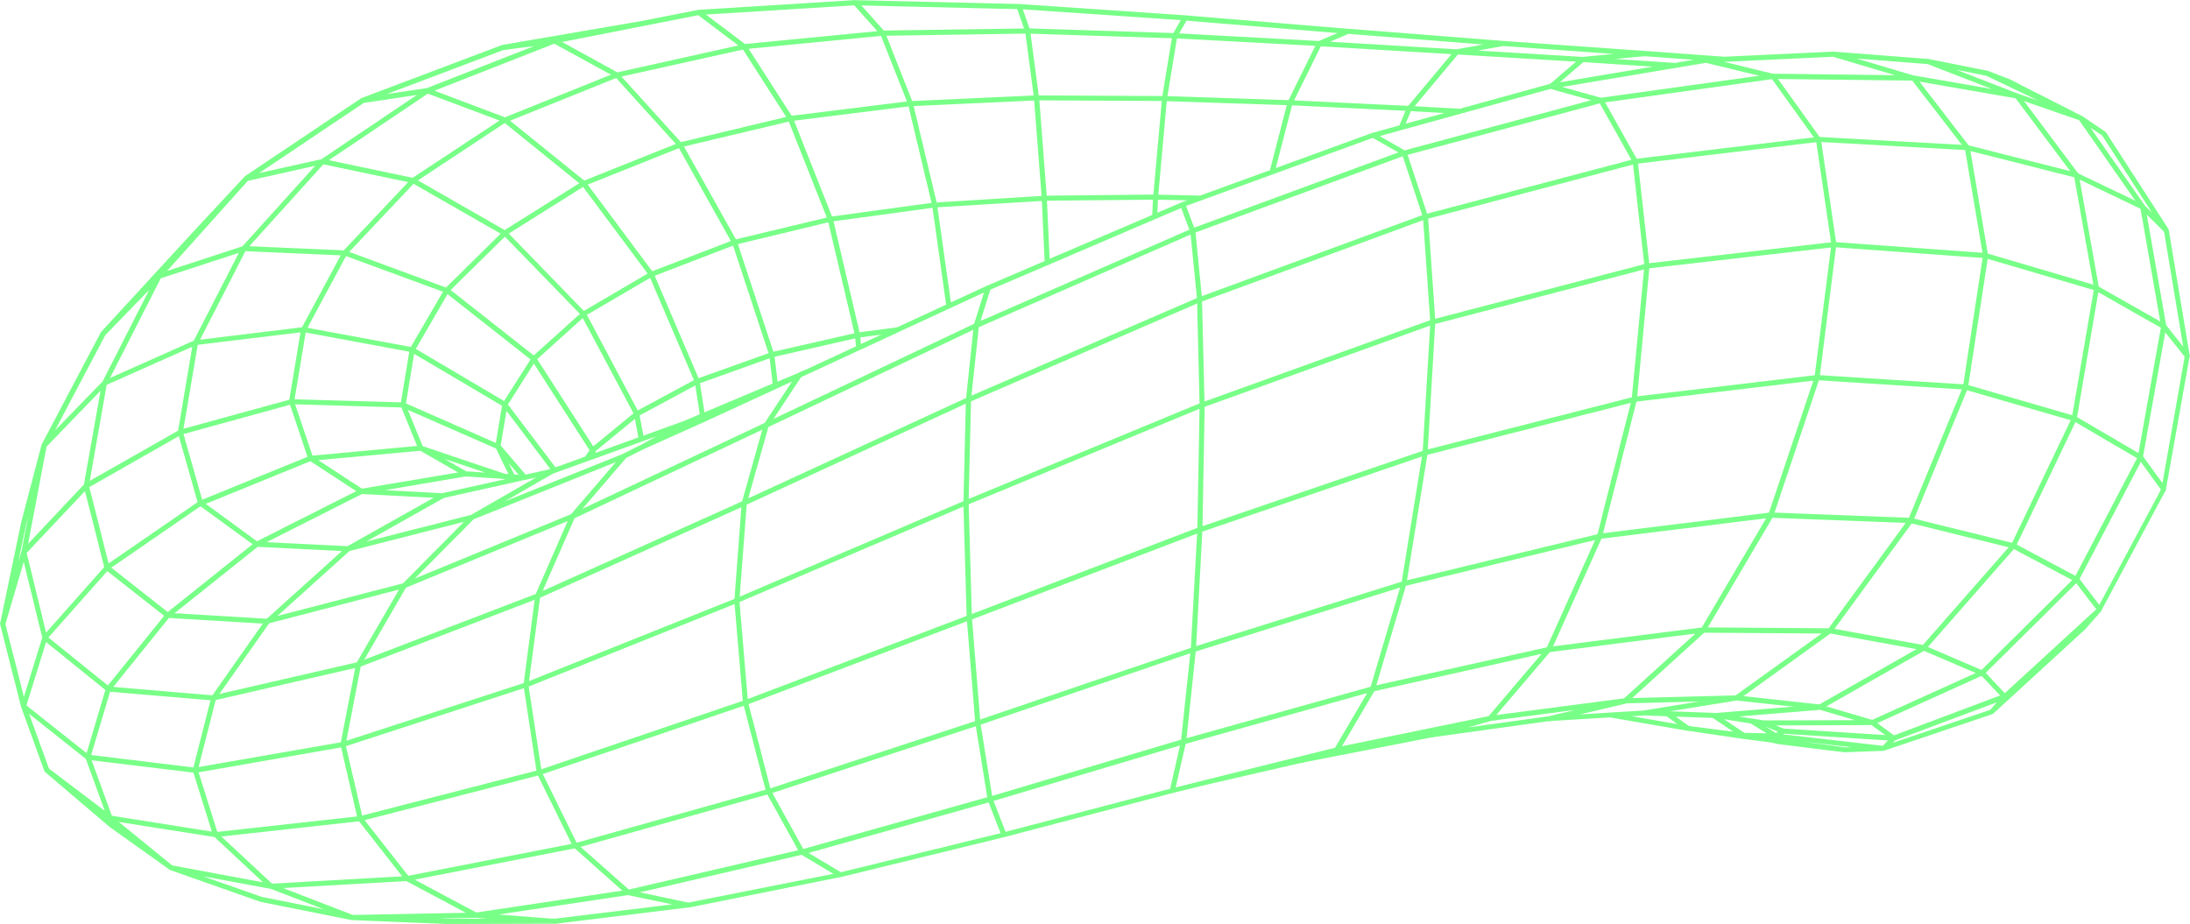
CONTENT
O
O
1
Problem Statement
"Challenges in Real-World Object Detection"
2
Objective
"Our Goal"
O
O
3
Solution Overview
"Our Approach"
4
Implementation Details
"How It Works"

Slide 3
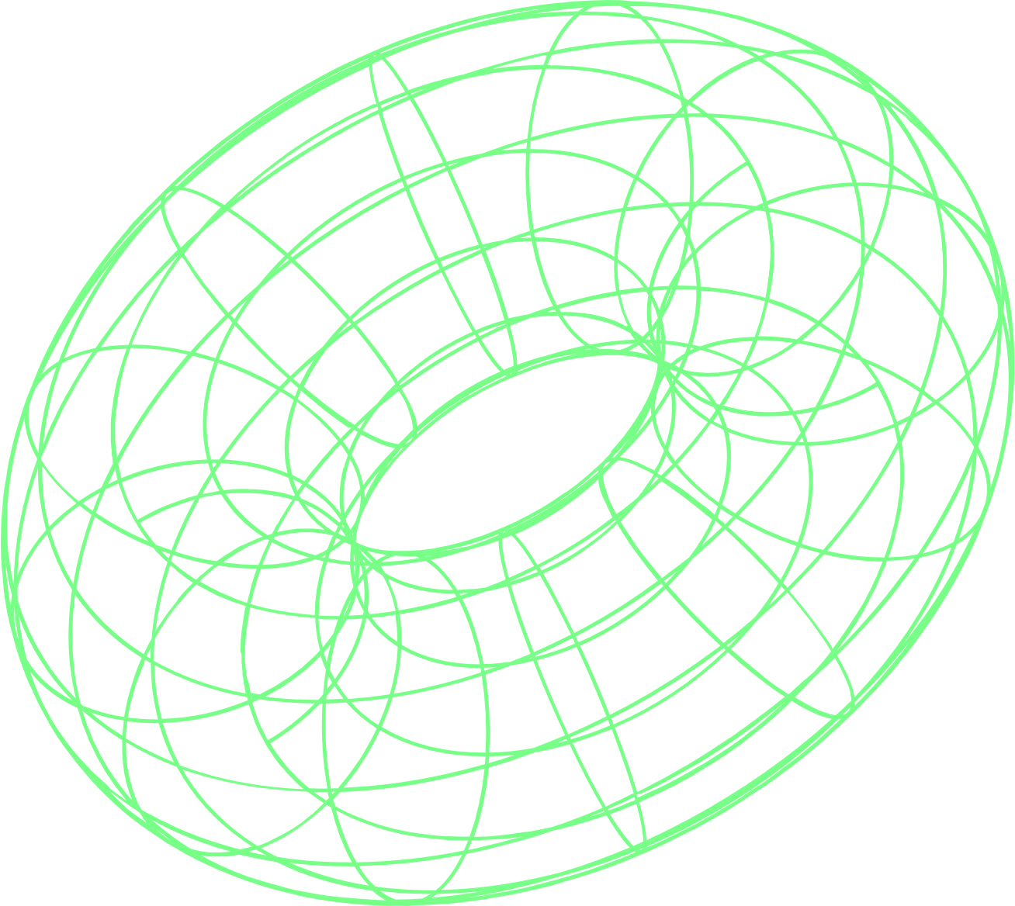
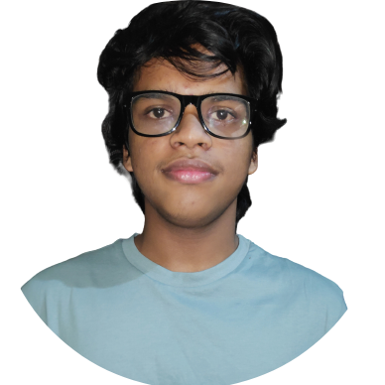
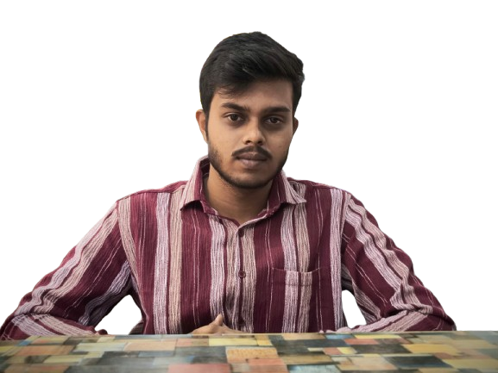
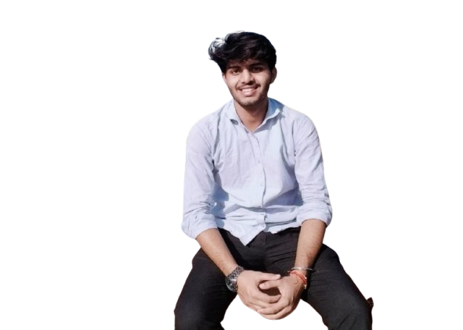
THE TEAM
Welcome to the Artificial Neural Network Conference 2023! We are excited to introduce you to our amazing team of organizers, speakers and volunteers who are working hard to make this event a success.Here are some of their names and positions, along with a brief bio.
O
Surya, Verma
Team Member
Key Responsibilities:
Fine-tuning the YOLOv8 model for object detection.
Handling dataset preparation, including annotation and augmentation.
Optimizing model performance and evaluating metrics like precision, recall, and inference speed.
Skills to Focus On:
Python, TensorFlow/PyTorch, YOLOv8 architecture, data preprocessing.
O
Pranjal Dubey,
Team Member
Key Responsibilities:
Implementing Kalman filter for tracking object trajectories and assigning IDs.
Integrating object detection outputs with tracking algorithms.
Working on ROI calibration and homography for speed estimation.
Skills to Focus On:
OpenCV, Kalman filter implementation, homography, and distance calculations.
O
Mayank Pandey,
Team Leader
Key Responsibilities:
Setting up and testing the end-to-end system (object detection, tracking, and behavior analysis).
Implementing system optimizations for edge devices or real-time processing.
Preparing visuals, results, and a demonstration video for submission.
Skills to Focus
On: Python scripting, system deployment, edge device optimization (e.g., NVIDIA Jetson or Snapdragon).

Slide 4

↖ ↗
↘ ↙
Problem Statement
1
"Challenges in Real-World Object Detection"

Slide 5
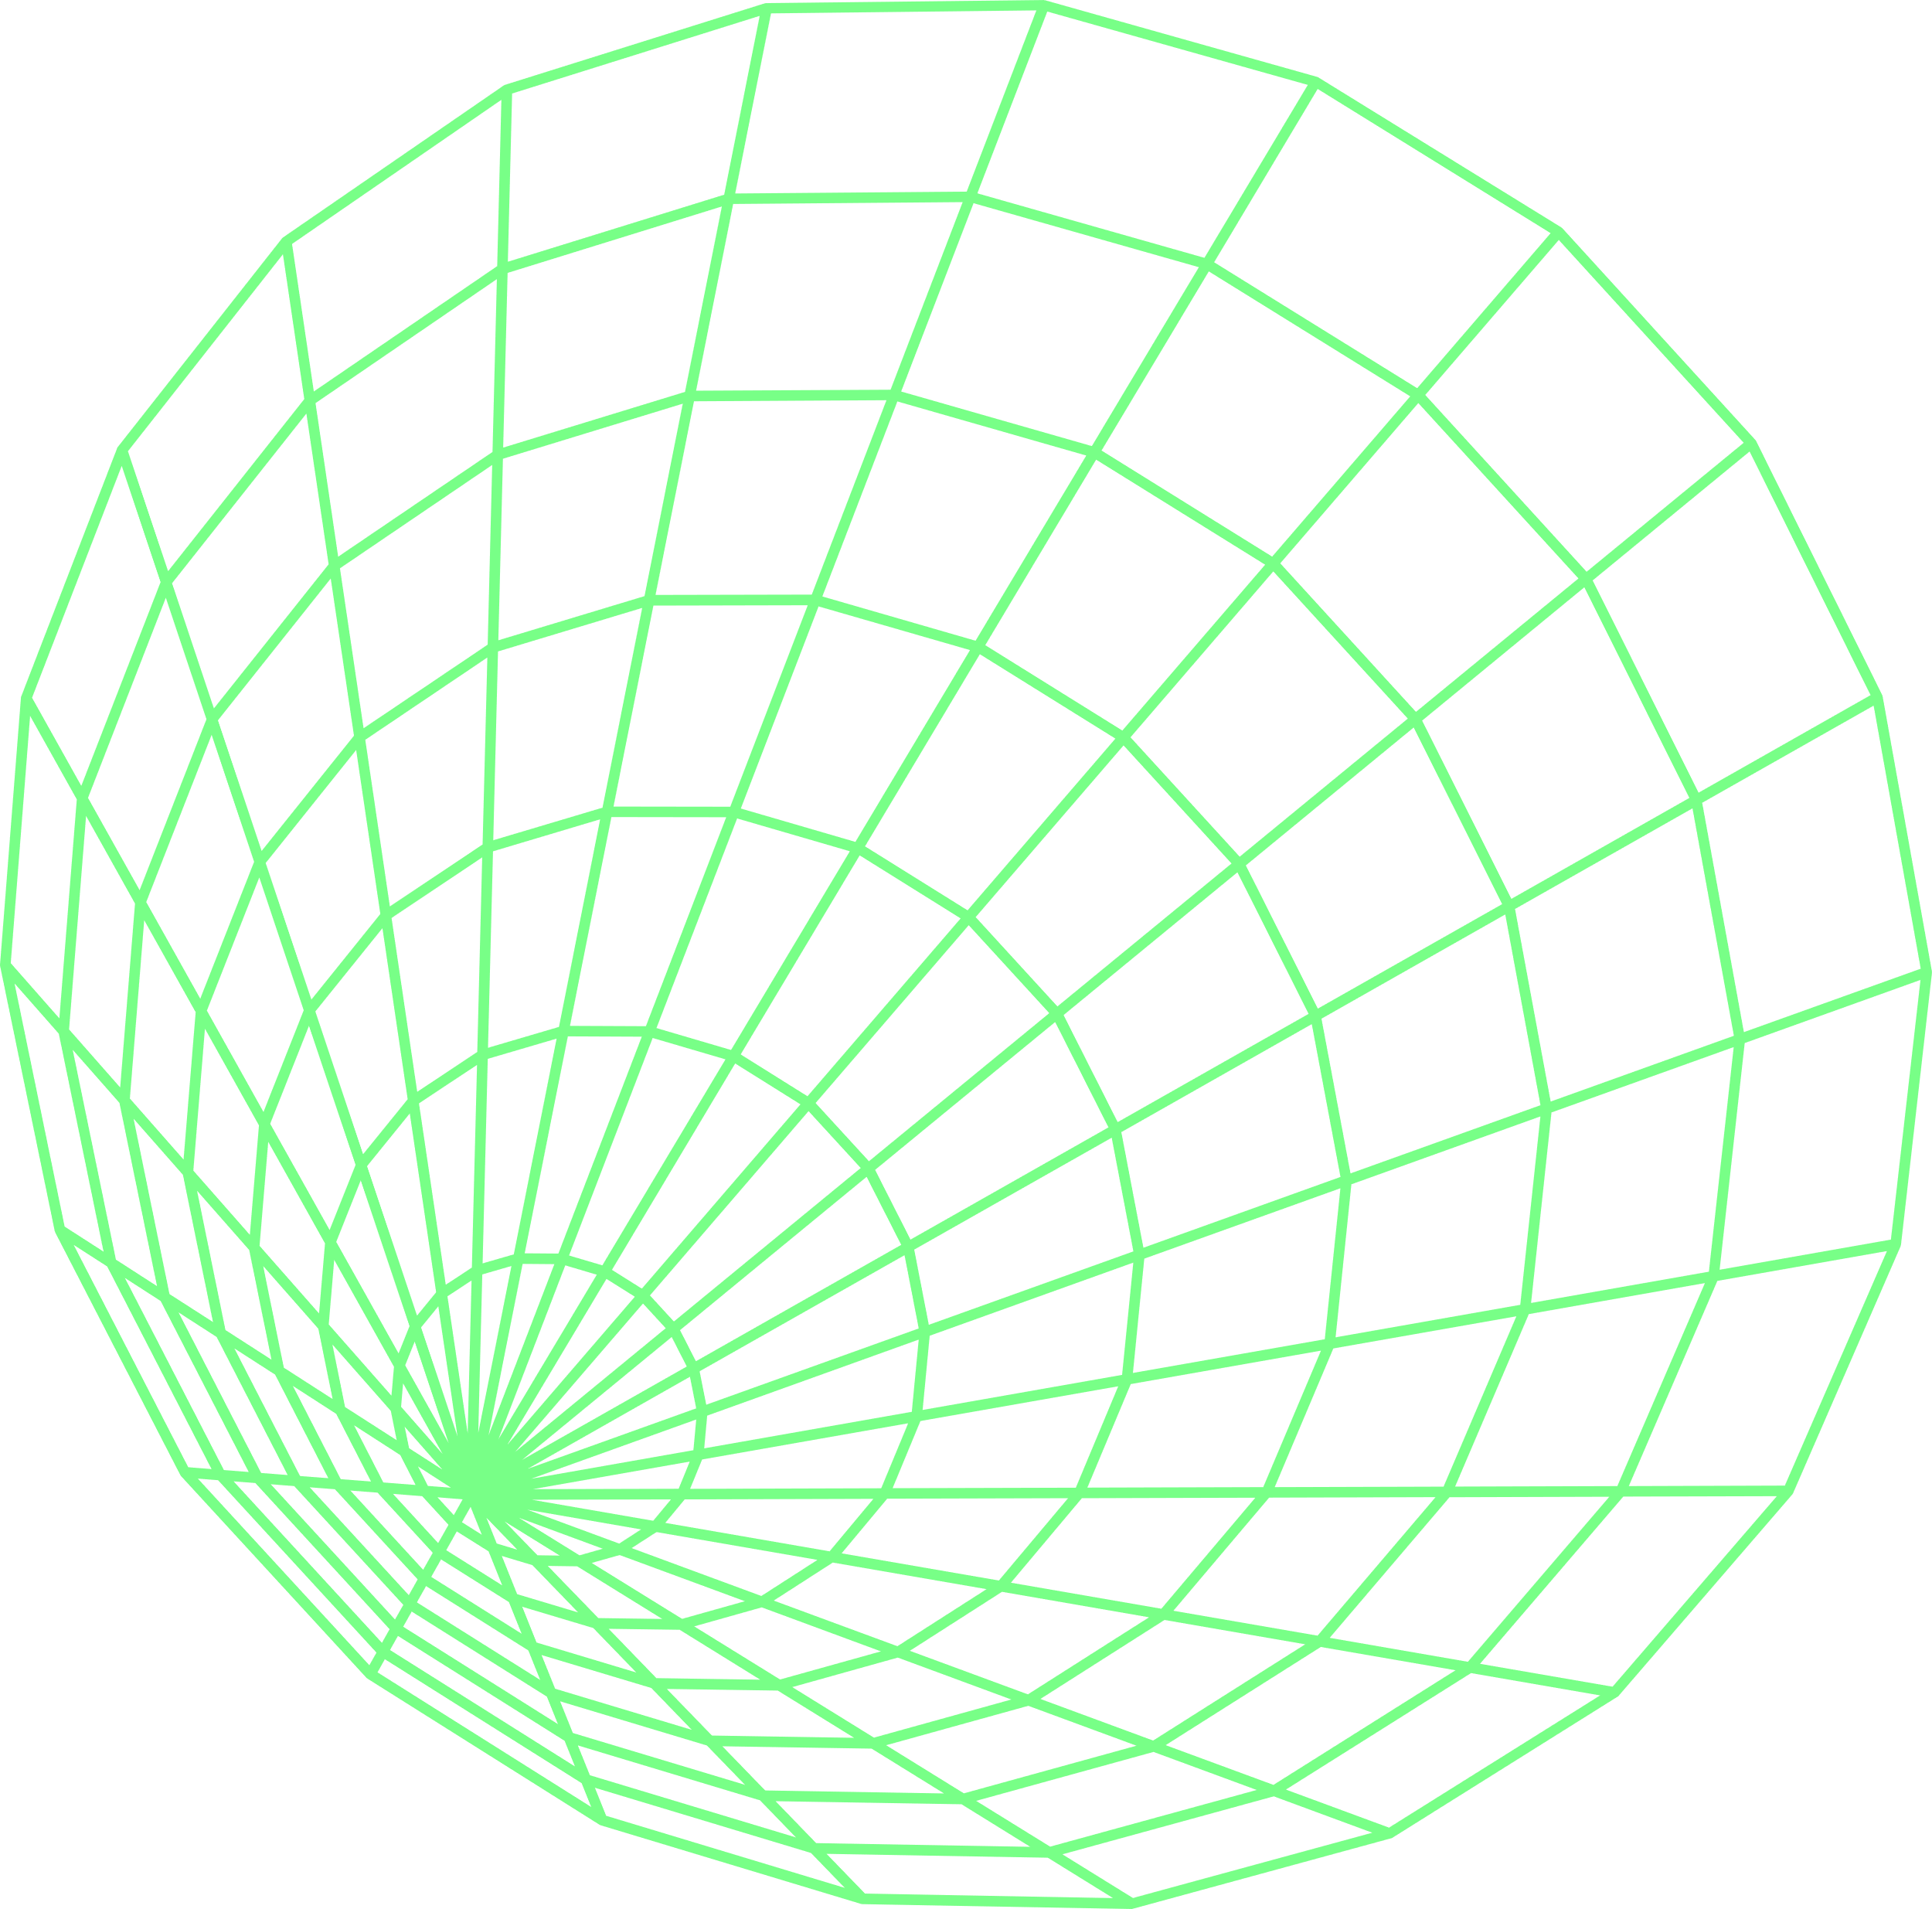
"Challenges in Real-World Object Detection"
In industries like construction, manufacturing, and traffic management, ensuring safety, quality, and efficiency is a significant challenge. Current methods rely heavily on manual oversight, which is time-consuming, error-prone, and often inefficient for real-time scenarios.
Key Challenges:
Construction Safety:
Ensuring workers adhere to safety protocols, such as wearing helmets, is critical.
Manual safety checks are inconsistent and fail to scale for large construction sites.
Non-compliance often leads to accidents, risking lives and project delays.
Industrial Quality Control:
Manufacturers need to verify product labeling, expiration dates, and packaging for compliance.
Manual inspection is prone to human error, especially in high-speed production lines.
Delayed error detection leads to increased costs and potential regulatory penalties.
Traffic and Industrial Safety:
Hazardous behaviors, such as erratic driving or unsafe machine operations, often go unnoticed until after incidents occur.
Traditional monitoring systems lack real-time decision-making capabilities and fail to predict or prevent accidents.

Slide 6
↖ ↗
↘ ↙
Objective
2
Our Goal

Slide 7
“Our Goal"
Vision: To develop a real-time, high-accuracy object detection system that addresses safety, quality, and operational challenges across industries.
Key Objectives:
1.Detect, classify, and localize multiple objects in real-time with minimal false positives/negatives.
2.Track object movements across video frames for enhanced situational understanding.
3.Create domain-specific solutions tailored to construction, manufacturing, and traffic safety scenarios.
Outcome: A scalable and robust AI solution deployable in diverse real-world environments.

Slide 8
↖ ↗
↘ ↙
Solution Overview
3
"Our Approach"

Slide 9
"Our Approach"
Key Features of the Solution:
Utilizes YOLOv8, a state-of-the-art object detection framework, for fast and accurate processing.
Incorporates OCR (Optical Character Recognition) for text-based analysis like reading expiration dates or labels.
Domain-specific fine-tuning to ensure optimal performance across scenarios:
Helmet detection for construction safety.
Label and expiration verification in quality control.
Hazardous behavior detection in traffic/industrial settings.
How it Works:
Real-time video feed or image processing.
Bounding box predictions for objects with detailed classification.
Alerts for detected anomalies or violations.

Slide 10
↖ ↗
↘ ↙
Implementation Details
4
"How It Works"

Slide 11
"How It Works"
Technology Stack:
YOLOv8: Fine-tuned for object detection.
Kalman Filter: Predictive tracking of objects.
Homography Transformation: Maps image points to real-world coordinates for speed estimation.
Programming Languages: Python with libraries like OpenCV, NumPy, and TensorFlow/PyTorch.
System Workflow:
Model Training: Fine-tune YOLOv8 using domain-specific datasets (e.g., annotated vehicles, helmets).
Detection and Tracking: YOLOv8 identifies objects; Kalman filter predicts their next positions and assigns IDs.
Speed Calculation: Use a homography matrix and ROI calibration for real-world speed estimation.
Behavior Analysis: Analyze object paths for erratic actions (e.g., sudden stops or deviations).

Slide 12
↖ ↗
↘ ↙
Real-World Applications
5
"Applications"

Slide 13
"Applications"
Traffic Monitoring:
Real-time vehicle tracking and speed estimation.
Immediate alerts for violations like speeding, lane deviations, or hazardous driving.
Construction Safety:
Monitor workers for compliance with helmet-wearing protocols.
Log violations with captured images.
Industrial Environments:
Analyze the movement of machinery or workers to detect unsafe behaviors.
Ensure quality control by identifying missing or misplaced components.

Slide 14
↖ ↗
↘ ↙
Challenges and Solutions
6
"Addressing Key Challenges"

Slide 15
"Addressing Key Challenges"
Challenges:
Handling object occlusion and maintaining tracking accuracy.
Processing high-speed objects in dynamic environments.
Ensuring real-time performance on edge devices.
Calibrating the system for speed estimation and behavior analysis.
Solutions:
Implement Kalman filters for smooth tracking and reassigning IDs.
Optimize YOLOv8 for high-speed scenarios with dataset augmentation.
Deploy on edge devices (e.g., NVIDIA Jetson or Qualcomm Snapdragon) for low-latency processing.
Use interactive calibration tools for precise ROI and speed measurements.

Slide 16
↖ ↗
↘ ↙
Metrics for Success
7
"Measuring Performance"

Slide 17
"Measuring Performance"
Evaluation Metrics:
Detection Metrics: Precision (e.g., 70%), Recall (e.g., 76%).
Tracking Metrics: ID consistency and tracking robustness across frames.
Behavior Analysis: Accurate identification of hazardous actions.
Inference Time: Real-time performance measured in FPS.
Speed Estimation Accuracy: Comparison with ground truth for validation.

Slide 18
↖ ↗
↘ ↙
Future Scope
8
"Scaling Beyond the Prototype"

Slide 19
"Challenges in Real-World Object Detection"
Short-Term Enhancements:
Refine behavior detection using machine learning.
Expand datasets to cover diverse weather, lighting, and object conditions.
Long-Term Vision:
Integrate with Qualcomm edge AI platforms for real-time scalability.
Develop advanced tracking techniques like DeepSORT for complex environments.
Enable multi-lane tracking and speed analysis for highways.

Slide 20
↖ ↗
↘ ↙
Conclusion
9
"Conclusion"

Slide 21
"Conclusion"
Challenges:
Handling object occlusion and maintaining tracking accuracy.
Processing high-speed objects in dynamic environments.
Ensuring real-time performance on edge devices.
Calibrating the system for speed estimation and behavior analysis.
Solutions:
Implement Kalman filters for smooth tracking and reassigning IDs.
Optimize YOLOv8 for high-speed scenarios with dataset augmentation.
Deploy on edge devices (e.g., NVIDIA Jetson or Qualcomm Snapdragon) for low-latency processing.
Use interactive calibration tools for precise ROI and speed measurements.

Slide 22
↖ ↗
↘ ↙
Objective
10
Our Goal

Slide 23
"Challenges in Real-World Object Detection"
Summary:
Combines YOLOv8, Kalman filters, and ROI calibration for robust object detection, tracking, and analysis.
Enhances safety, efficiency, and operational effectiveness across industries.
Final Note:
The solution bridges AI innovation with real-world applications, setting a standard for scalable deployments in safety and automation.

Slide 24
↖ ↗
↘ ↙
References
11
"References"

Slide 25
"Challenges in Real-World Object Detection"
Technologies:
YOLOv8, Kalman filter, OpenCV, and Python-based libraries.
Homography-based speed estimation tools.
Research Papers, Articles, or Datasets:
Include relevant sources or links to datasets and tools.

Slide 26
OUTRO
"We look forward to your feedback and are excited to discuss how our solution can make an impactful difference in diverse industries."
HAPPY VisionING!

Slide 27

THANK
YOU
"We appreciate your time and attention to our presentation. VisionAI is our commitment to using cutting-edge AI technology to tackle real-world challenges in safety, quality, and efficiency."

